Slide 1
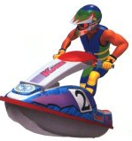

WAVE RACE PROJECT
Interactive Graphics 2016
Coratti Stefano
1624508
coratti.s86@gmail.com
SAPIENZA - DIAG
Interactive Graphics 2016

Slide 2
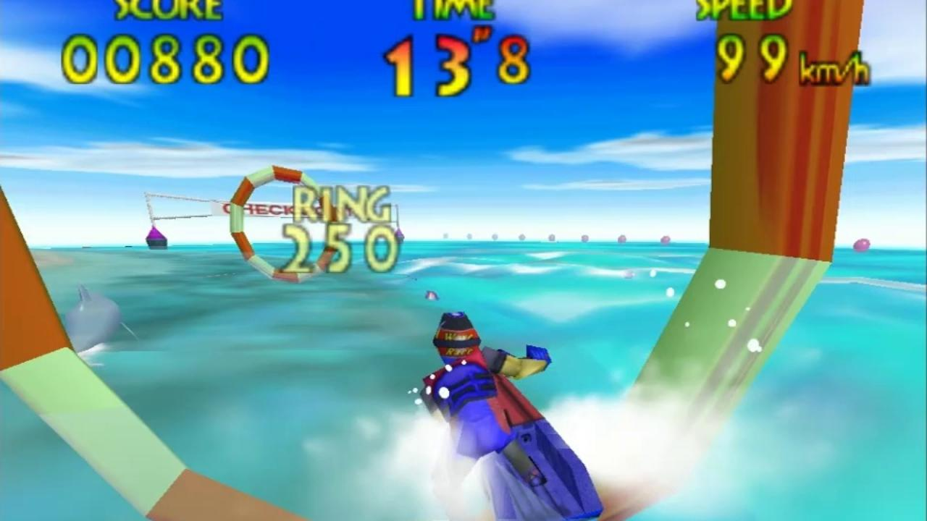
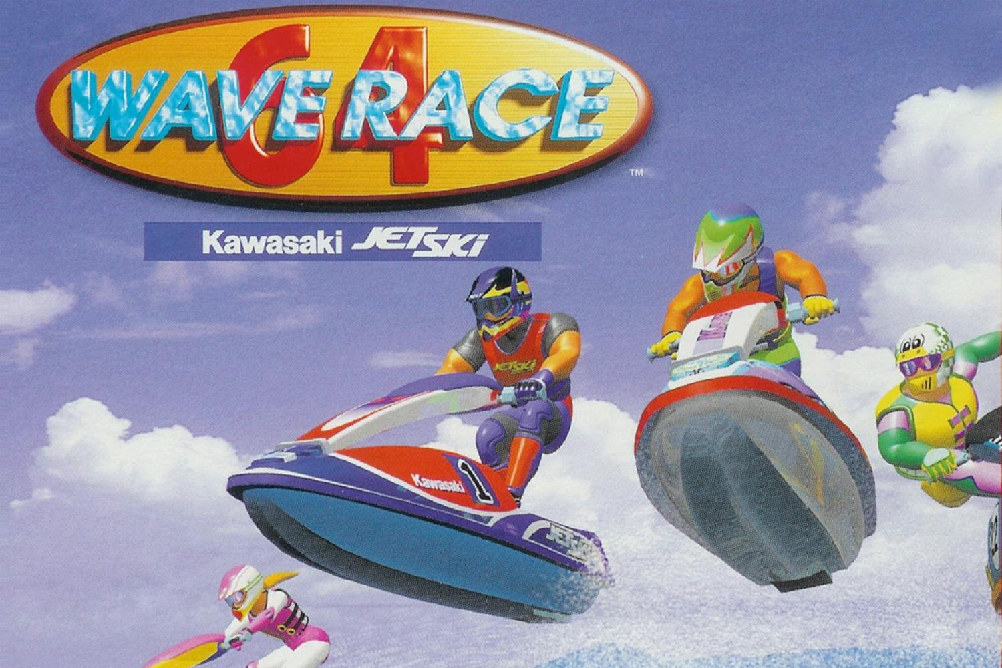
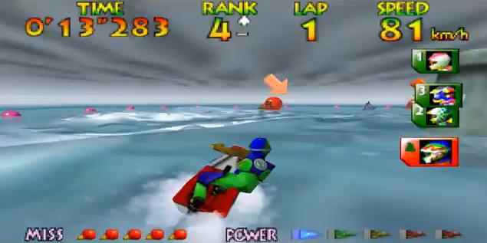
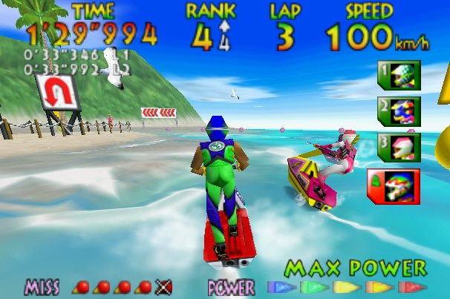
WAVE RACE 64
The original video game by NINTENDO
SAPIENZA - DIAG
Interactive Graphics 2016

Slide 3
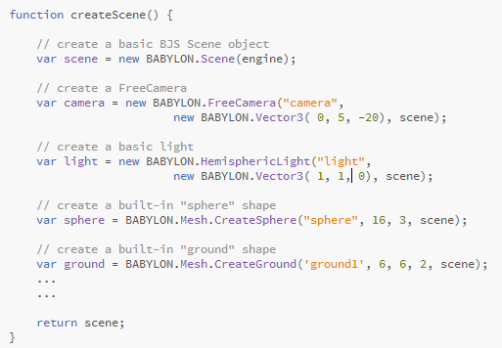
INTRODUCTION TO BabylonJS
Scene
cameras
lights
basic elements
materials
gravity & collisions
animations
environment
particles
SAPIENZA - DIAG
01
Interactive Graphics 2016

Slide 4



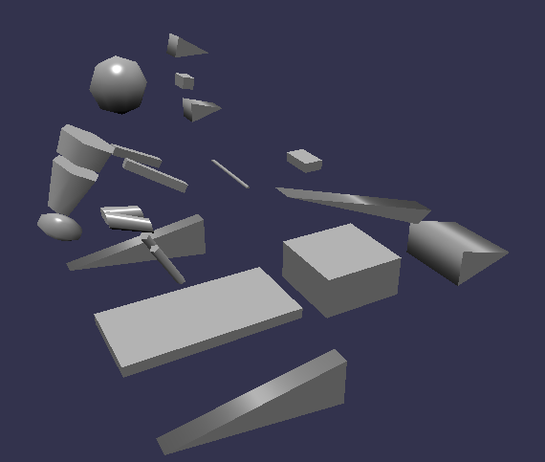
Basic Objects
In my project I use basic objects, provided by Babylon.js
like spheres, boxes, cylinder, torus, etc…
SAPIENZA - DIAG
02
Interactive Graphics 2016

Slide 5
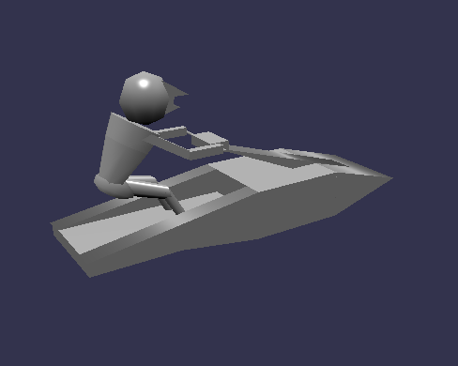
Basic Objects
In my project I use basic objects, provided by Babylon.js
like spheres, boxes, cylinder, torus, etc…
SAPIENZA - DIAG
03
Interactive Graphics 2016

Slide 6
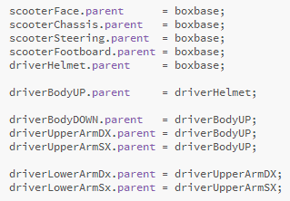
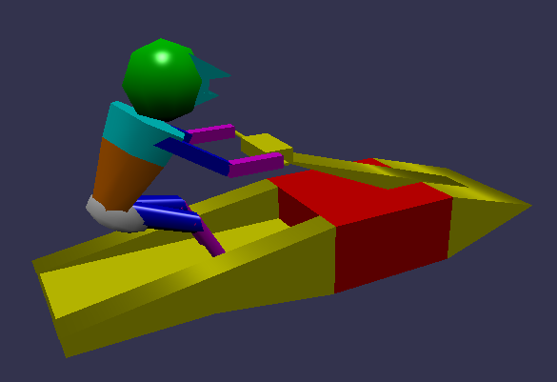
Hierarchical
Modeling complex connected structures with hierarchical structure,
made up of multiple simpler objects.
boxBase
scooterFace
driverHelmet
scooterChassis
scooterSteering
scooterFootboard
driverBodyUP
driverUpperArmSX
driverBodyDOWN
driverUpperArmDX
driverLowerArmSX
driverLowerArmDX
SAPIENZA - DIAG
04
Interactive Graphics 2016

Slide 7



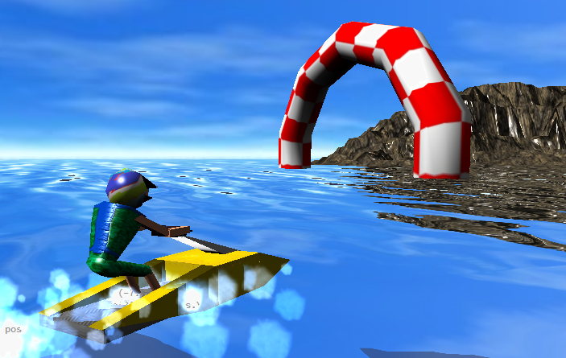

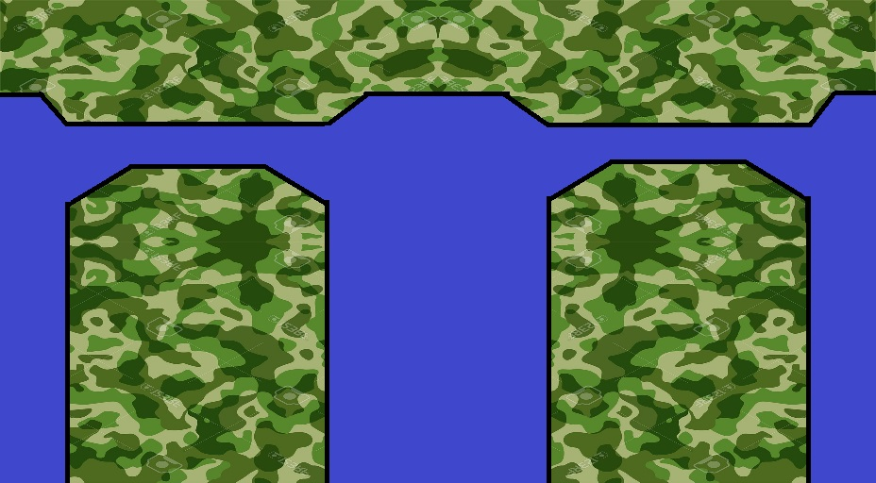

Material
For each object it is possible to define a Material, that allow to assign colors, textures and lights
SAPIENZA - DIAG
05
Interactive Graphics 2016

Slide 8
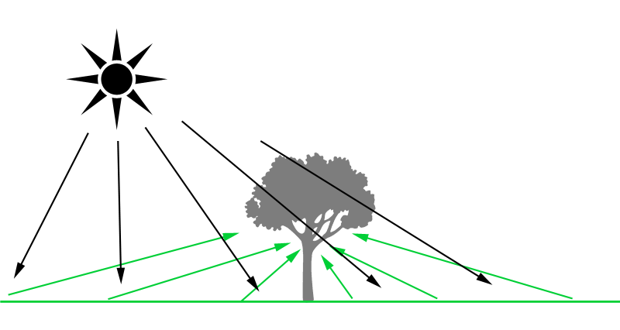


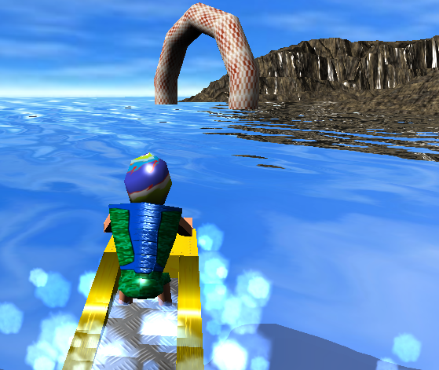

Ambient Light
Hemispheric light is used to simulate realistic ambient environment light,
defined by a direction to the sky, that is often straight upward (0, 1, 0)
Soft Light
Directional Light
The light is emitted from everywhere...
toward a specific direction, and has an infinite range.
SAPIENZA - DIAG
06
Interactive Graphics 2016

Slide 9
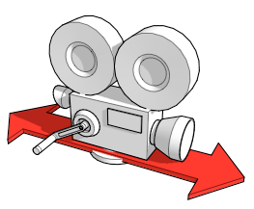
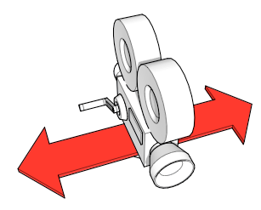
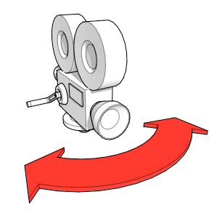
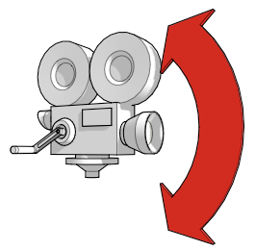
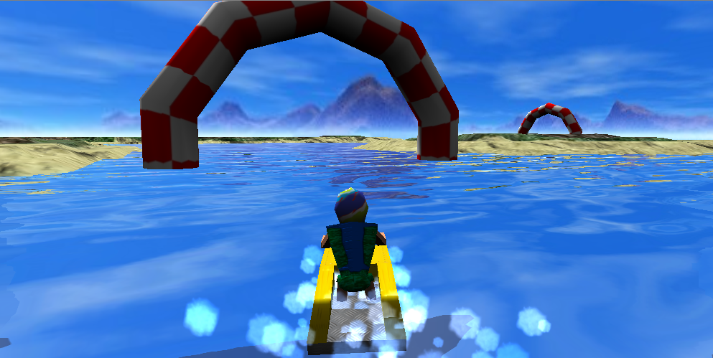

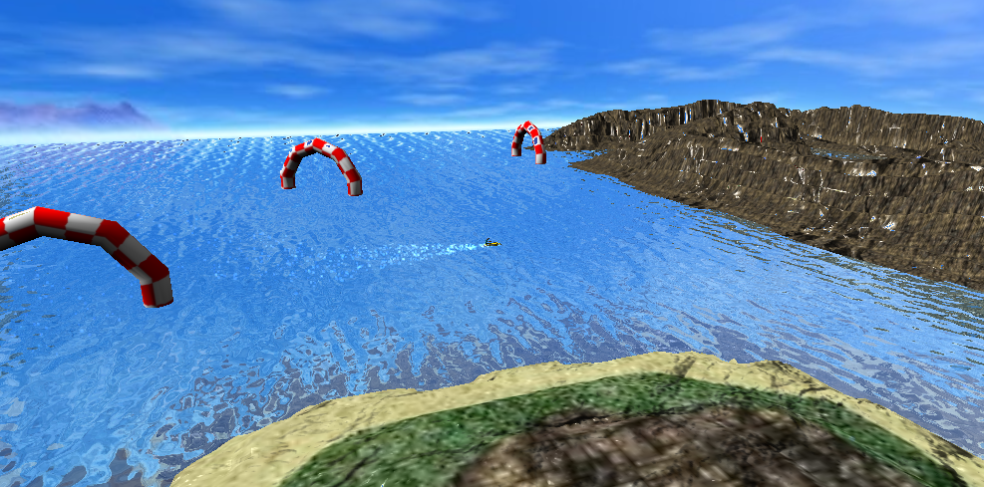
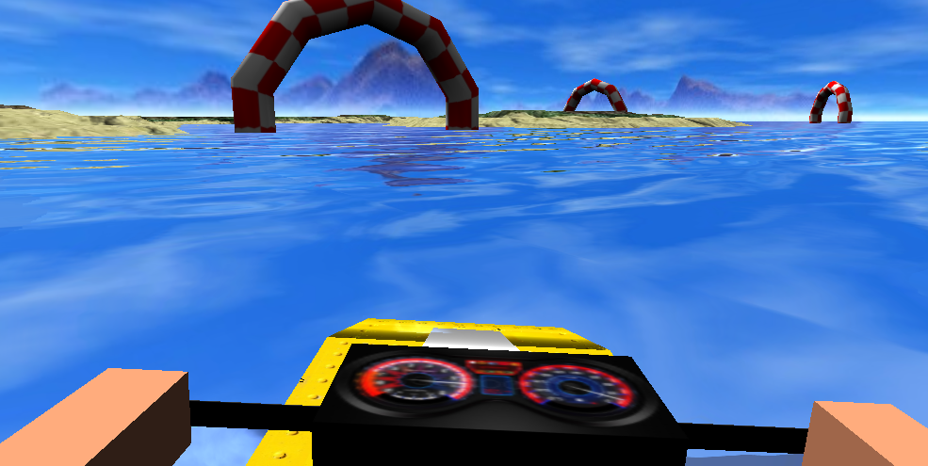

FreeCamera
You can move around the scene with mouse and cursor keys
SAPIENZA - DIAG
07
Interactive Graphics 2016

Slide 10
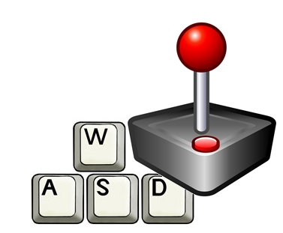
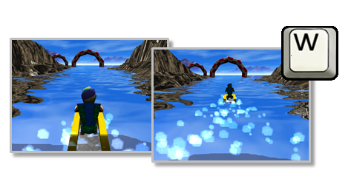
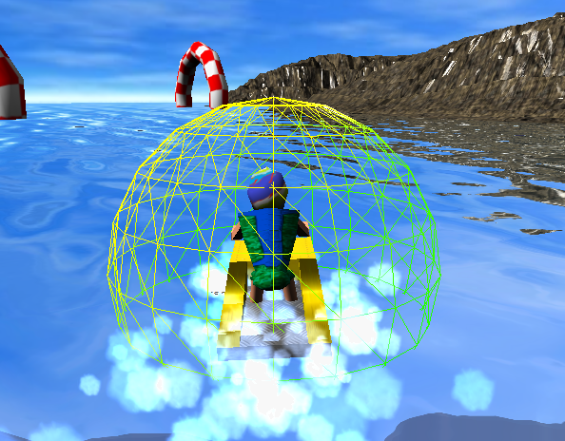

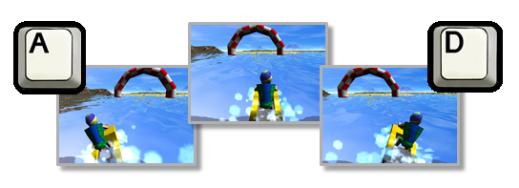

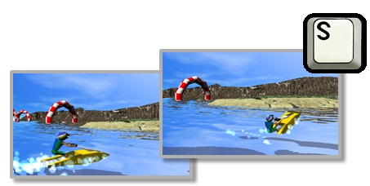
Interaction
It is possible to drive the scooter over the sea,
using the keyboard as controller
Pos_Driver
Pressing the key W the scooter
is translated along the Z axis,
in according to its local coordinates
Pressing the keys A or D the scooter is rotated along the Y axis,
and there is a little rotation along Z axis to simulate inclination,
in according to its local coordinates
Pressing the key S the scooter is boosted,
in this case the scooter is rotated along the X axis
in according to its local coordinates
SAPIENZA - DIAG
08
Interactive Graphics 2016

Slide 11
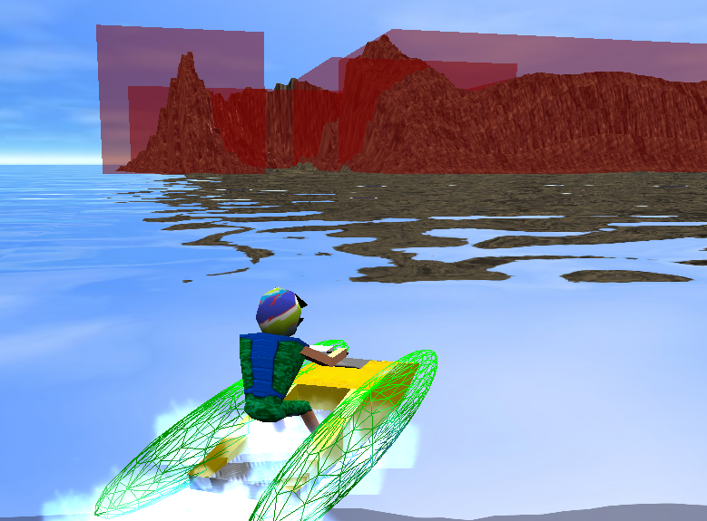
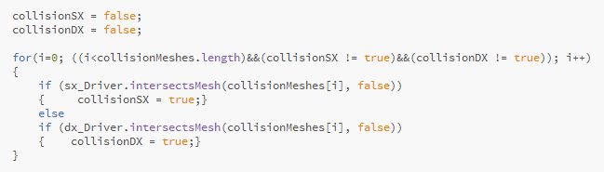
Mesh Collision
When meshes are in contact with each other ,
for each frame the engine check if meshes collide
bounding box
around the objects
approximation
sphere meshes
for the driver
SAPIENZA - DIAG
09
Interactive Graphics 2016

Slide 12
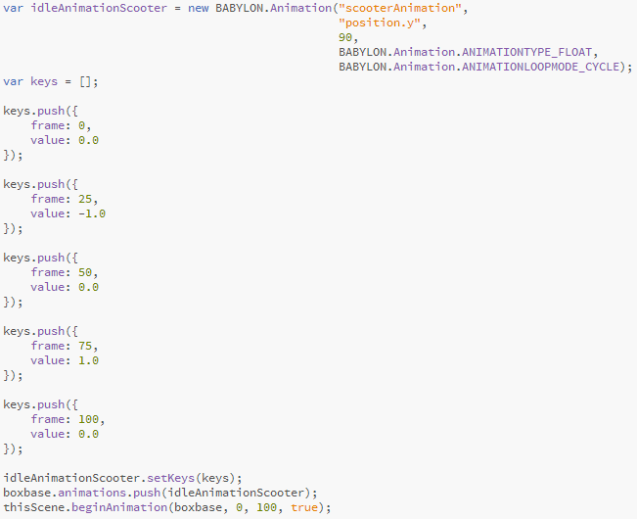
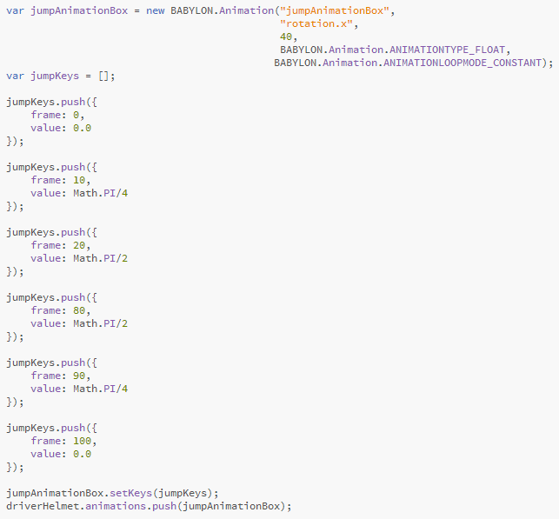
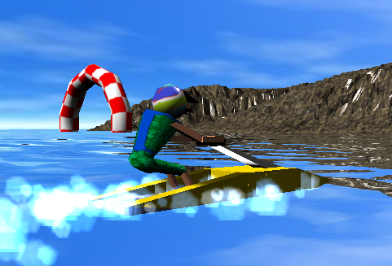
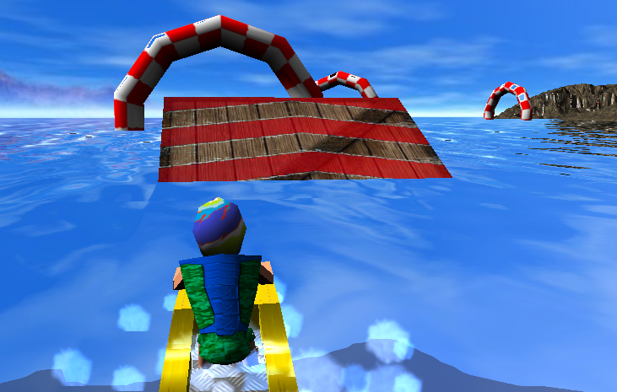
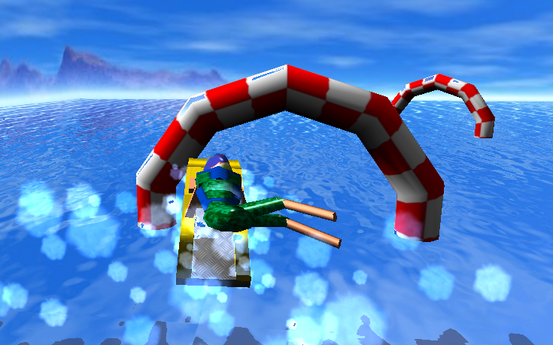
Idle Scooter Animations
This animation is used to simulate the oscillatory
behavior of the scooter on the sea
Acrobatic Animations
This animation is used to simulate an acrobatic behavior
SAPIENZA - DIAG
10
Interactive Graphics 2016

Slide 13
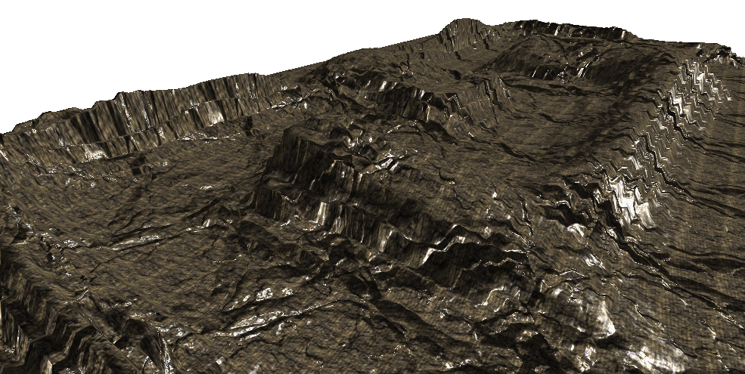
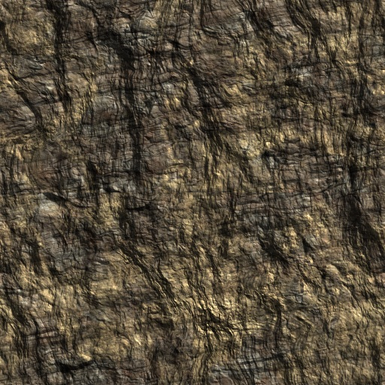

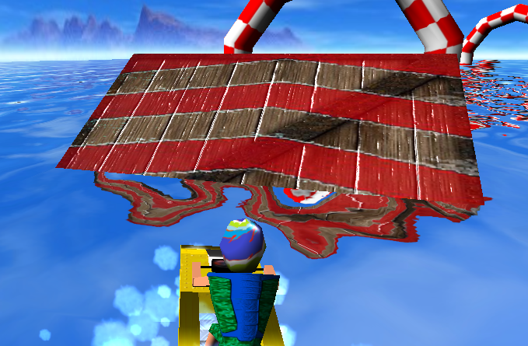
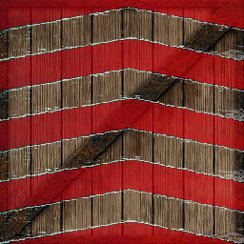
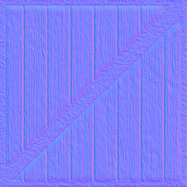
Height Mapping
Allow to model a surface like terrain easily,
is a raster image used to store surface height data,
contains one channel interpreted as a height from the floor of a surface
Bump Mapping
Is a technique for simulating bumps and wrinkles on the surface of an object,
this is achieved by perturbing the surface normals
and using them during lighting calculations.
11

Slide 14
GO TO SIMULATION
SAPIENZA - DIAG
12
Interactive Graphics 2016

Slide 15
Thanks for the Attention
Any questions ?
SAPIENZA - DIAG
Interactive Graphics 2016

